Slide 1
Training Dataset

Slide 2
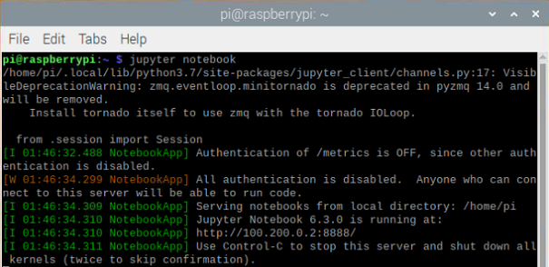
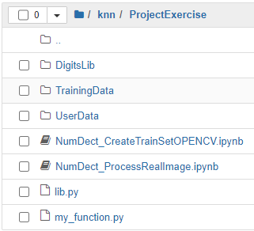
jupyter notebook
jupyter notebook --ip=127.0.0.1
character set
generated training set
sample image
training set generation code
Image processing and identification codes
function realization
Contents

Slide 3
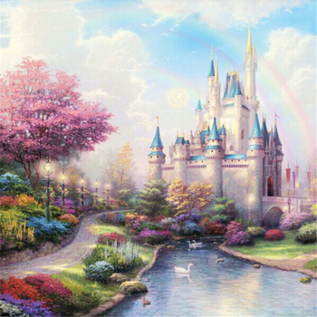

[[[169 236 162]
[148 152 98 ]
[56 214 140]]
[[146 244 204]
[63 162 155]
[158 214 200]]
[[69 181 83 ]
[138 143 150]
[188 136 156]]]
Color picture
Pixel
Python
[169 236 162] [148 152 98 ] [56 214 140]
[146 244 204] [63 162 155] [158 214 200]
[69 181 83 ] [138 143 150] [188 136 156]
169
148
56
146
63
158
214
188
236
152
69
138
162
214
244
140
181
143
136
162
98
204
155
200
83
150
156
Pixel & Color

Slide 4
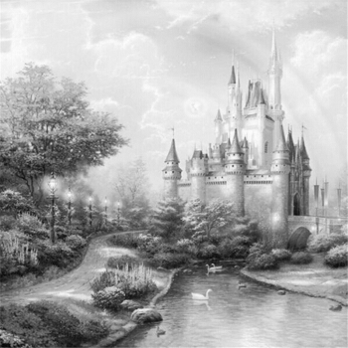
[[[169 236 162] [148 152 98 ] [56 214 140]]
[[146 244 204] [63 162 155] [158 214 200]]
[[69 181 83 ] [138 143 150] [188 136 156]]]
Color picture
1：）Gray = B ; Gray = G ; Gray = R
2：）Gray = max({B , G , R})
3：）Gray = (B + G + R) / 3
4：）Gray = 0.11 * B + 0.59 * G + 0.3 * R
5：）Gray = 0.072169 * B + 0.715160 * G + 0.212671 * R # opencv
[[178 154 150]
[208 150 200]
[102 147 154]]
Gray picture
Grayscale Images

Slide 5
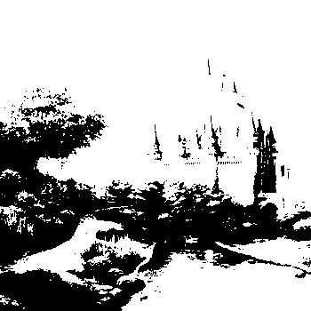
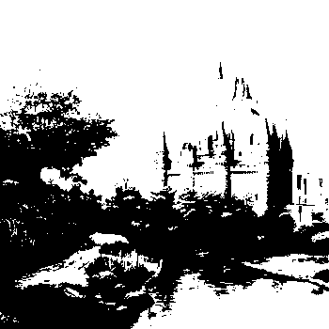
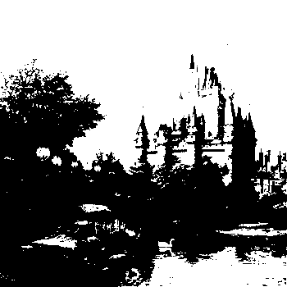
Binary Images
[[178 154 150]
[208 150 200]
[102 147 154]]
>threshold, 255, white
<=threshold, 0, black
Threshold：150
Threshold：175
Threshold：200
[[255 255 0]
[255 0 255]
[ 0 0 255]]
[[255 0 0]
[255 0 255]
[ 0 0 0]]
[[ 0 0 0]
[255 0 0]
[ 0 0 0]]

Slide 6

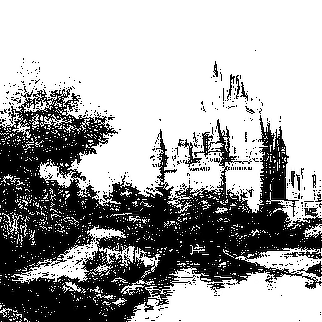
Filter
cv2.fastNlMeansDenoising()
Gray
cv2.cvtColor()
Binary
cv2.threshold()
dilate&erode
cv2.getStructuringElement
cv2.dilate cv2.erode
[[[169 236 162]
[148 152 98 ]
[56 214 140]]
[[146 244 204]
[63 162 155]
[158 214 200]]
[[69 181 83 ]
[138 143 150]
[188 136 156]]]
[[[169 236 162]
[148 152 98 ]
[56 214 140]]
[[146 244 204]
[63 162 155]
[158 214 200]]
[[69 181 83 ]
[138 143 150]
[188 136 156]]]
[[178 154 150]
[208 150 200]
[102 147 154]]
[[255 255 0]
[255 0 255]
[ 0 0 255]]
[[255 0 0]
[255 0 255]
[ 0 0 255]]
[[255 0 255]
[255 0 255]
[255 0 255]]
Image preprocessing

Slide 7
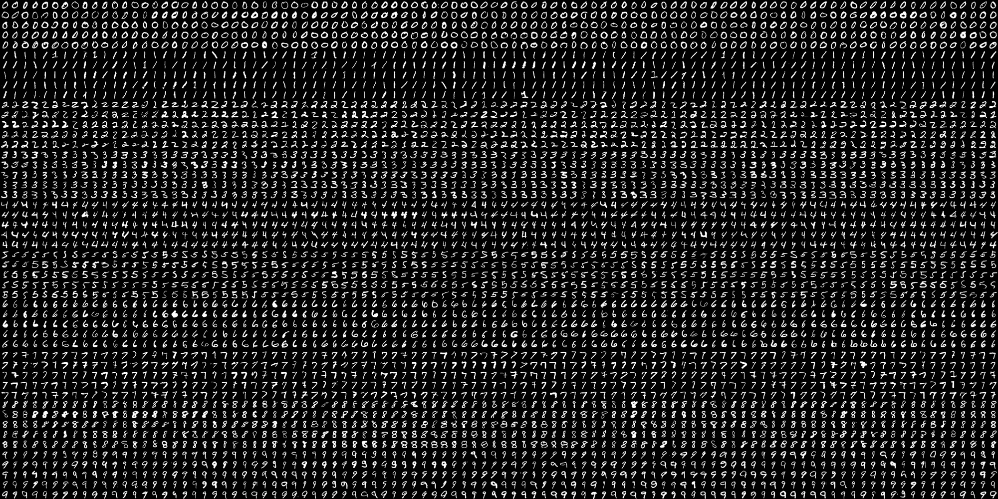
1 2 3 . . . . . . . . . . . . . . . . . . . . . . . . . . . . . . . . . . . . . . . . . . . . . . . . . . . . . . . . . . . . . . . . . . . . . . . . . . . . . . . . . . . . . . . . . . . . . . . . . . . . . . . . . . . . . . . . . . . . . . . . . . . . . . . . . .99 100
1
2
3
.
.
.
.
.
.
.
.
.
.
.
.
.
.
.
.
.
.
.
.
.
.
.
.
.
.
.
.
.
.
.
48
49
50
digits.png

Slide 8
1 2 3 . . . . . . . . . . . . . . . . . . . . . . . . . . . . . . . . . . . . . . . . . . . . . . . . . . . . . . . . . . . . . . . . . . . . . . . . . . . . . . . . . . . . . . . . . . . . . . . . . . . . . . . . . . . . . . . . . . . . . . . . . . . . . . . . . 99 100
1
2
3
.
.
.
.
.
.
.
.
.
.
.
.
.
.
.
.
.
.
.
.
.
.
.
.
.
.
.
.
.
.
.
.
.
.
.
48
49
50
20x20
Split

Slide 9
trainLabels
3: [0 0 0 0 0 0 0 0 0 0 1 1 1 0 0 0...0]
trainData
[0 0 0 0 0 0 0 0 0 0 1 1 1 0 0 0...0]
[[0 0 0 0 0 0 0 0]
[0 0 1 1 1 0 0 0]
[0 1 0 0 0 1 0 0]
[0 0 0 1 1 0 0 0]
[0 0 0 0 0 1 0 0]
[0 1 0 0 0 1 0 0]
[0 0 1 1 1 0 0 0]]
Labeling
trainLabels
[[0]
[1]
[2]
[3]
[4]
[5]
[6]
[7]
[8]
[9]]
trainData
[[0 0 0 0 0 0 1 1 1 1 1 1 1 0 0 0...0]
[0 0 0 0 0 0 0 0 1 1 1 0 0 0 0 0...0]
[0 0 0 0 0 0 0 1 1 1 1 1 0 0 0 0...0]
[0 0 0 0 0 0 1 1 1 1 1 1 0 0 0 1...0]
[0 0 0 0 0 0 1 1 0 0 1 1 1 0 0 0...0]
[0 0 0 0 0 0 1 1 0 0 0 0 0 0 0 0...0]
[0 0 0 0 0 0 0 0 0 1 1 1 1 0 0 0...0]
[0 0 0 0 0 0 1 1 1 1 1 1 1 1 1 0...0]
[0 0 0 0 0 0 1 1 1 1 1 1 0 0 0 1...0]
[0 0 0 0 1 1 1 1 1 1 1 1 1 0 1 1...0]]
Reshape
Get the single digit
Training Dataset

